Slide 1
MOOCs, OERs and Consciousness
Stephen Downes
AU 801 - Advanced Topics and Issues in Distance Education
November 14, 2017

Slide 2
Wait, what….? Consciousness?
OK, let’s set the stage:
- OERs are needed for MOOCs (and open learning generally)
- MOOCs are based on Connectivism
- and Connectivism is based on neural networks
- and neural networks are the source of consciousness
So for today, let’s work in the other direction, from our understanding of consciousness, to what learning (MOOCs, OERs) need to be

Slide 3
Heather: seeking solutions
Carla Tilley: fleeting sound bites of random data
Nan: planning, budgets, hiring
Corine: awareness of your presence and your surroundings
Jenaro: Asking the right questions
Kelli: awareness of stimuli
leeann: constant passing thoughts unless meditating
Dianne Conrad: anxiety
Nan: ate too much chocolate today
Jessica: rhizomes
Michael Dabrowski: an emergent property of neurons firing creating a stream of consciousness
Corine: yes mine
Corine: well I am aware that you are there
Kelli: no such thing as too much, Nan...
Jessica: in the Deleuze and Guattari sense ;)
Nan: Term paper and the need to finish writing it
Lisa: concern about my son
leeann: coaching myself to quiet mind
What’s in your head?
No, not zombies.
https://www.youtube.com/watch?v=8MuhFxaT7zo

Slide 4
Consciousness as sensation
- that is, sensation as the whole of cognition
- yes, there may be cities and things out there
but they’re not in your head
- consciousness as simple
- it’s not something over and above neural
interaction and activation
- it’s not a ‘view’ of neural interaction and activation
- Eliminative Materialism
https://plato.stanford.edu/entries/materialism-eliminative/

Slide 5
Mental content?
- there is no means to infer from sensation to an external world
- We can't infer to universal propositions
(what Chomsky called Plato's problem).
- We can't generalize to laws of nature
(this is the problem of induction).
- We disentangle theory from data
(this is shown in Quine's two dogmas of empiricism).
- the external world is something we sense directly
- J.J. Gibson - direct perception

Slide 6
it needs to make sense to me and connect the dots between related ideas
Katherine: logic
Corine: logic
Nan: evidence and substantiation
Debra: it needs a why
leeann: Michael - yes
Kelli: Relates representation of stimuli to experience
Carla Tilley: I can accept your explanation as it is your experience and your experience may influence my future understanding of a similar experience - constructivism
Corine: agreed Carla
Jessica: I feel like im waiting for Aristotle's "whole is greater than sum of parts" to make me feel special and not just a cluster of neurons etc.
Michael Dabrowski: @Jessica, but you are a sum of the neurons.
Michael Dabrowski: and it's abolutely amazing that you are conscious.
Jessica: Yey I'm special! Thank you lol
Kelli: The whole arises from the parts, and the parts can be rearranged
Jessica: hahaha
Kelli: There's only one Jessica!
Kelli: Nope... responding to Jessica
Jessica: don't try to rearrange me Kelli
Kelli: I said an explanation is relating represetnation of stimuli to experience
leeann: I get the neuron science part but how is menaing created then
But this isn’t an explanation of consciousness, is it?
- how do you explain other things?
- How do you frame explanations in your research?
- what do you expect from an explanation? Think about it…

Slide 7
A common idea of explanation has come to underlie modern scientific method as described by most non-specialists
- We observe regularities in nature
(perhaps through experimentation or problem-solving)
- We infer to a universal principle
(through a process of induction (or maybe, abduction)).
- We would then test, verify, and confirm this principle…
- Which becomes a scientific theory & ultimately a law of nature.
The problem is, it doesn't work.

Slide 8
Why Not?
- basically, for the same reasons we can’t infer from
sensation to an external world
- no principle of logic or reason that will allow an inference
from concrete experience to abstract universal
- even if we could derive a universal there is no way to
confirm, verify, or falsify it using data alone
- Explanations today are subject to principles of evaluation
- consistency, clarity, comprehensiveness, utility
- parsimony or simplicity (Ockham’s razor)

Slide 9
But wait – How are students learning anything then?
- are they just memorizing sounds and shapes?
- are they constructing reality? But how?
leeann: they are adapting to what is acceptable in the area they are studying?
Nan: I worked once in a culture in which the dream state was considered reality
Debra: reconstructing constantly in concert with others
leeann: the common beliefs as shared by their teachers
Corine: I am sticking with constructing
Dianne Conrad: Love that example, Nan
Kelli: They are experiencing, and comparing their experiences to others' experiences, through which common representation/understanding is negotiated
Michael Dabrowski: They are constructing a subject reality from a personal perspective on the universe and their individual sensory inputs.
Carla Tilley: you are constructing your reality and learning as you construct
Heather: making an explanantion of the stimui
Heather: stimuli
Jessica: deduction plus intuition
Jenaro: Some scientists claim we dream reality up
Nan: Thanks Dianne. The traditional healer actually made decisions based on dreams.
Debra: the reconstruction is learning expansion of knowledge
Michael Dabrowski: I would think that drugs are a great example to show that reality and everything we belive to be real is a fluid thing.
Dianne Conrad: One man's ceiling is another man's floor...
(Hint: David Hume says it’s through custom and habit)
http://www.philosophypages.com/hy/4t.htm

Slide 10
Here’s the Story
- the human brain is composed of layers of connected neurons.
- the top layer (or outermost layer) is the sensory layer.
- these are densely interconnected with the next layer
- and the next, and so on through the visual cortex
- through to inner layers, and beyond
- Consciousnessis the firing of these inner layers of neurons
- the more complex the interaction,
the more conscious the person.

Slide 11
Layers of Neurons in the Brain
Senses
Cortex
Inner
Deep
Consciousness

Slide 12
These connections are self-organizing
- neural networks are prediction engines
- we are constantly predicting what we expect next
- these appear as sensations (or part of sensations)
along with our other sensations
- it’s a natural process – no construction, no management
- this includes language
- mentally, a language is nothing more than a series of
shapes and sounds we read, hear and speak
- the formal properties of language (syntax, semantics, etc)
aren’t part of consciousness at all

Slide 13
These connections are self-organizing
- neural networks are prediction engines
- we are constantly predicting what we expect next
- these appear as sensations (or part of sensations)
along with our other sensations
- it’s a natural process – no construction, no management
- this includes language
- mentally, a language is nothing more than a series of
shapes and sounds we read, hear and speak
- the formal properties of language (syntax, semantics, etc)
aren’t part of consciousness at all

Slide 14
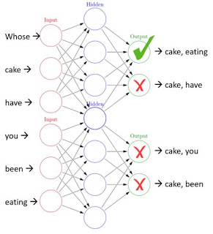
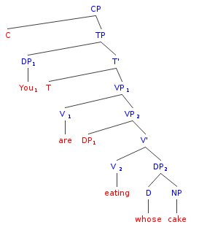
Whose cake are you eating?

Slide 15
Semantics is association
- this isn’t just a statement about language, it’s a statement
about knowledge generally
- people aren’t ‘constructing models’ in their minds, they’re
constructing them in the world – in social communities
- but if they’re learning, they’re creating associations
(which are, literally, connections between neurons)
This assertion is the core of Wittgenstein's private language argument.

Slide 16
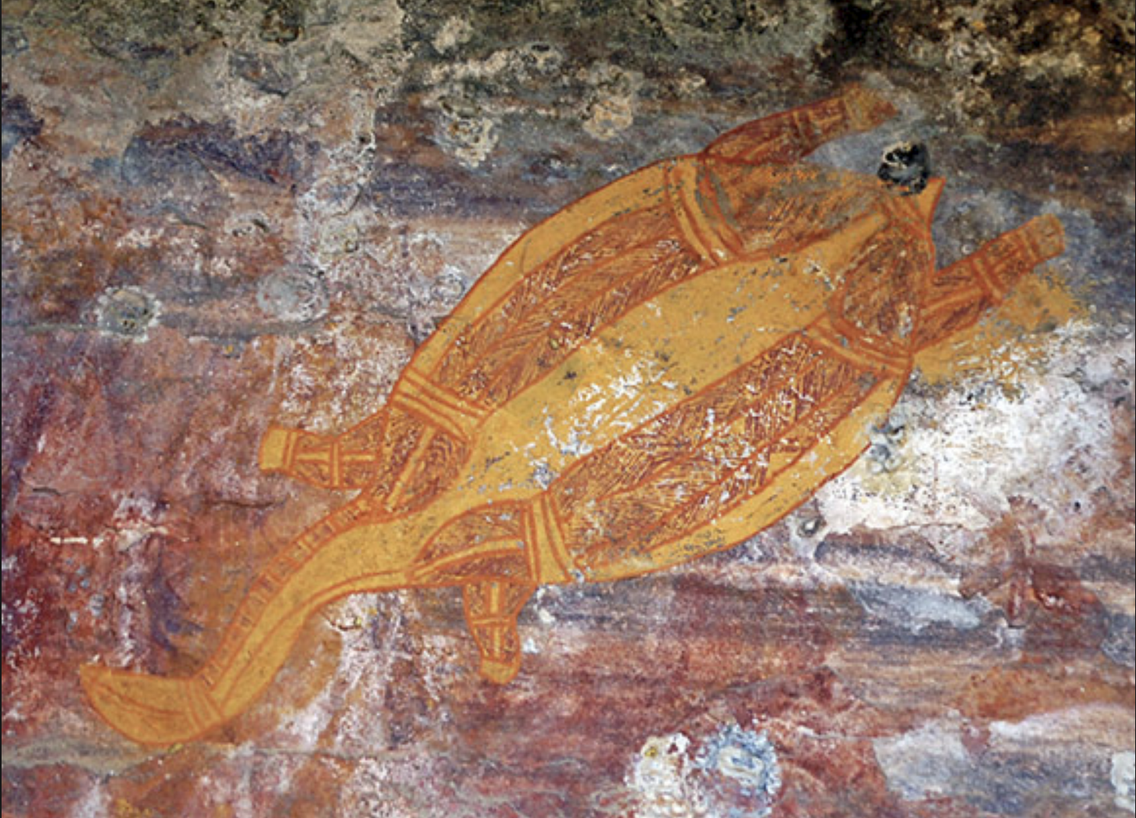
Learning, association, signs
- A sign is a part of the natural world.
- Everything leaves signs (or traces, or tracks, or indications)
- You learn about the future the way you learn about the past,
by reading the signs - http://www.downes.ca/presentation/109

